Slide 1

Airbnb NYC

Slide 2
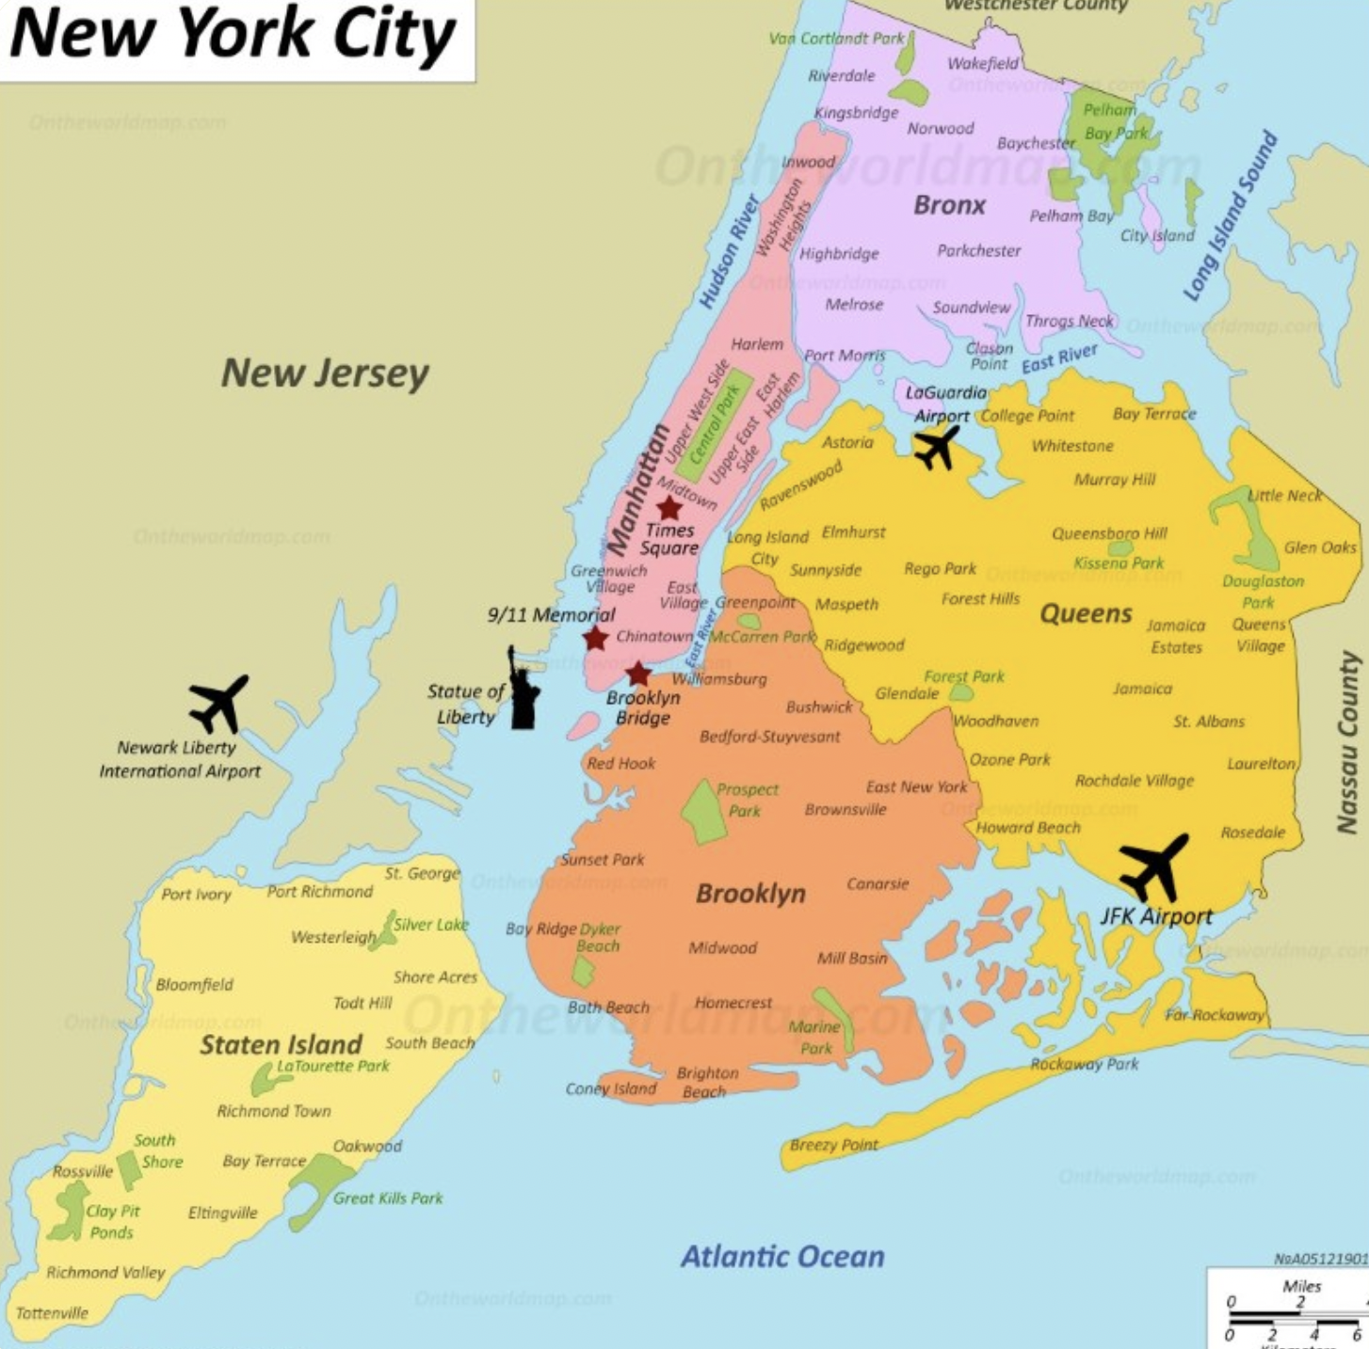
Contents
Hypotheses
Data Cleaning
Plots using: Jupyter
Spyder / Streamlit Dashboard

Slide 3

Hypotheses / INTRO

Slide 4
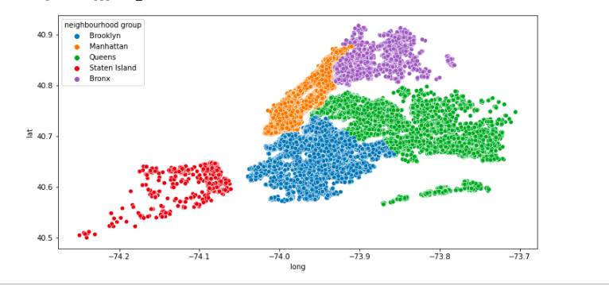
Airbnb’s of nyc

Slide 5
Data Cleaning
Replaced empty values in Name with unknown
Host identity we replaced empty values with unconfirmed
Replaced empty values in Host Name with unknown
Dropped missing values from neighberhood and neighberhood group
We dropped country and country code
We replaced missing values with false in instant bookable
Replaced missing values in cancellation policy with unspecified
We dropped missing values from construction year
We dropped price column and replaced it with price_per_night
Service fee we dropped the missing values
Missing values in minimum nights we replaced by unspecified
We dropped license column

Slide 6
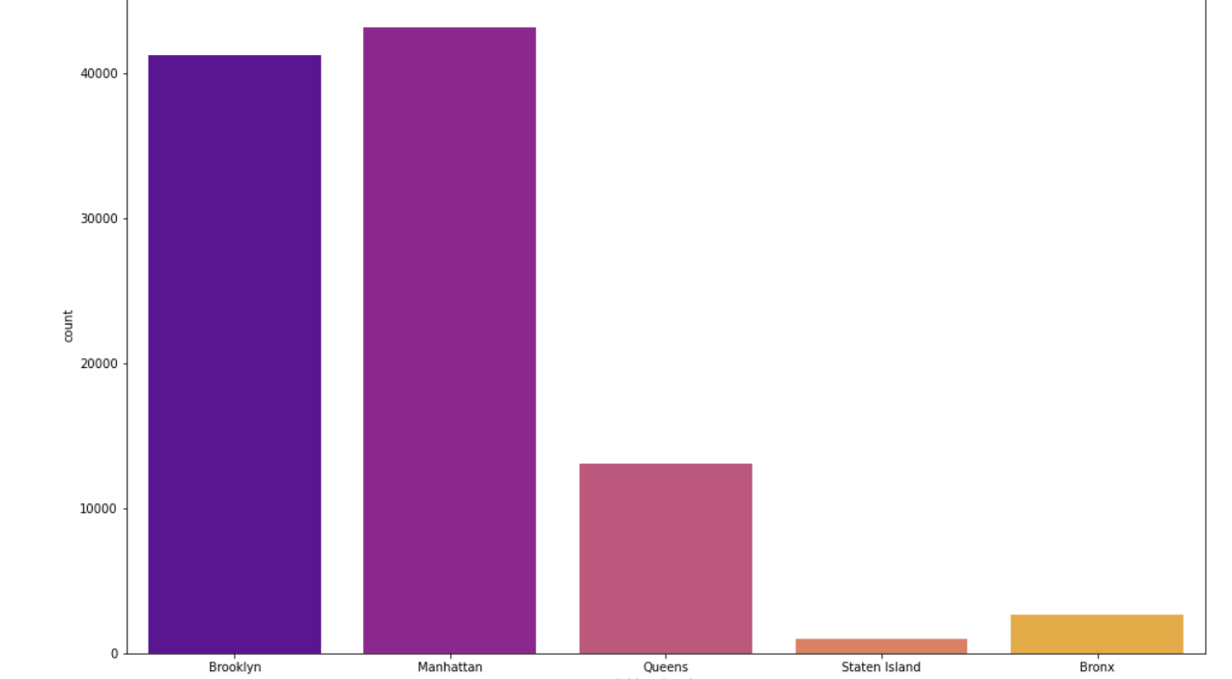
Jupyter pLOTS

Slide 7
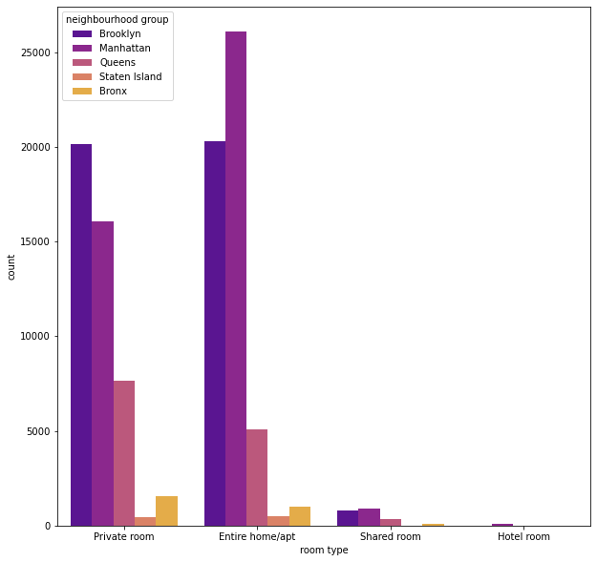
Jupyter pLOTS

Slide 8
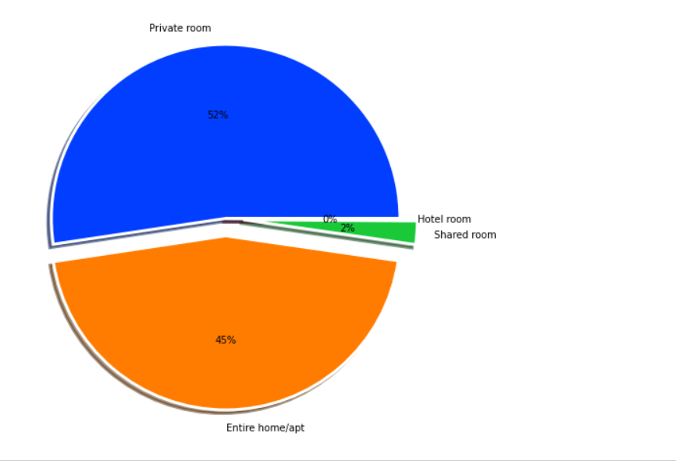
Jupyter pLOTS

Slide 9
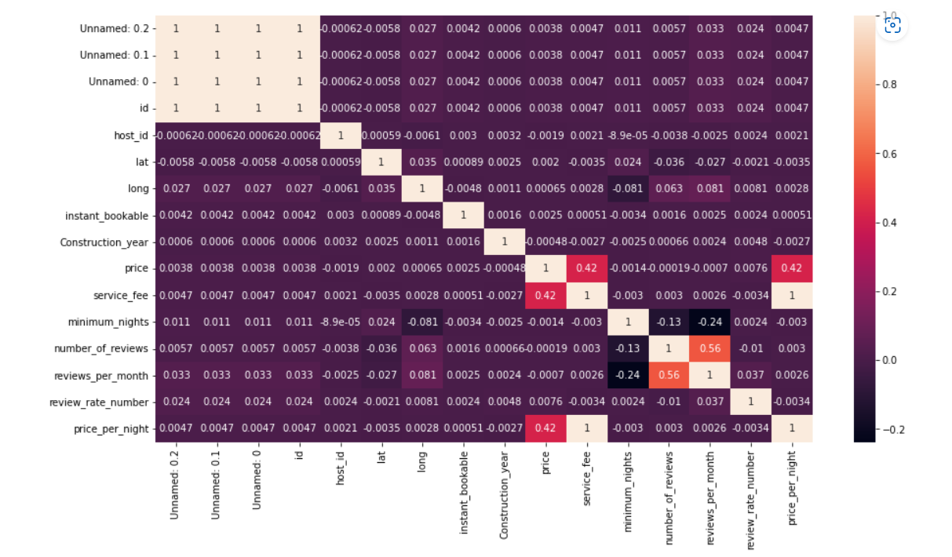
Jupyter pLOTS

Slide 10
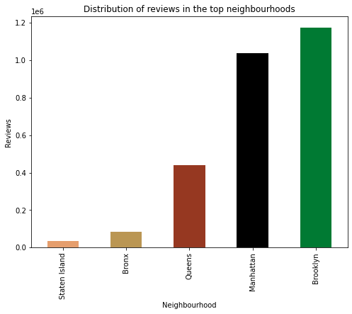
Jupyter pLOTS

Slide 11
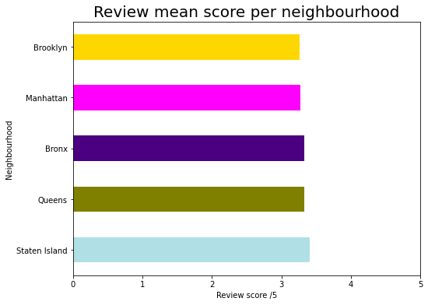
Jupyter pLOTS

Slide 12
Spyder / Streamlit Dashboard

Slide 13
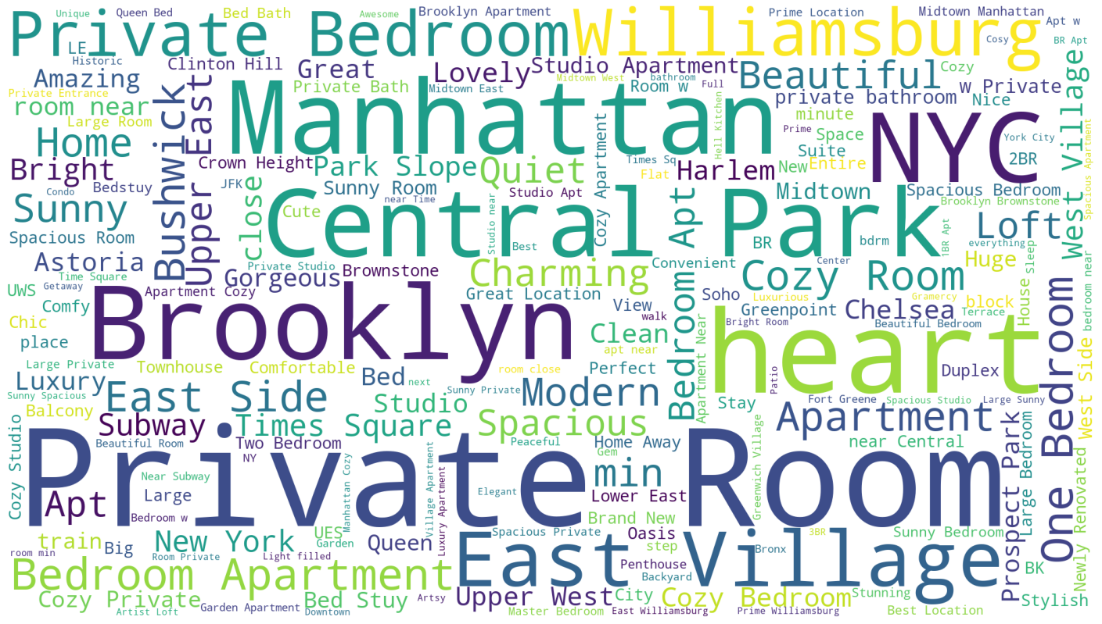
Outro

